Slide 1
CSCI561 Fall 2018 Week 9 Discussion
Prof Sheila Tejada
Prof Wei-min shen
Prof Ning wang
cs561-l@mymaillists.usc.edu
cs561-l@mymaillists.usc.edu

Slide 2
Material covered by midterm
Covers everything studied in class up to and including Planning (chap. 7-10,12) , October 29, 8pm
Lectures vs Disussion vs book: what to know?
if a topic is studied in lecture/discussion and is also in the book: need to know both.
if a topic is studied in lecture/discussion only and is not in the book: know what was studied in class.
if a topic is in the book but was not covered at all in class: no need to know.
Opening the exam before you are given the go signal will result in automatic filing of a case with the office of student judicial affairs.
Cheating during the exam will result in automatic filing of a case with the office of student judicial affairs.
Continuing to write after the stop signal will result in automatic filing of a case with the office of student judicial affairs.

Slide 3
Agent and KB
How to design this?
Sensors
percepts
Environment
KB
Agent
actions
Effectors

Slide 4
Midterm 2 Review
Knowledge-Based Agent
Agent that uses prior or acquired knowledge to achieve its goals
Can make more efficient decisions
Can make informed decisions
Knowledge Base (KB): contains a set of representations of facts about the Agent’s environment
Each representation is called a sentence
Use some knowledge representation language, to TELL it what to know e.g., (temperature 72F)
ASK agent to query what to do
Agent can use inference to deduce new facts from TELLed facts
Domain independent algorithms
ASK
Inference engine
TELL
Knowledge Base
Domain specific content

Slide 5
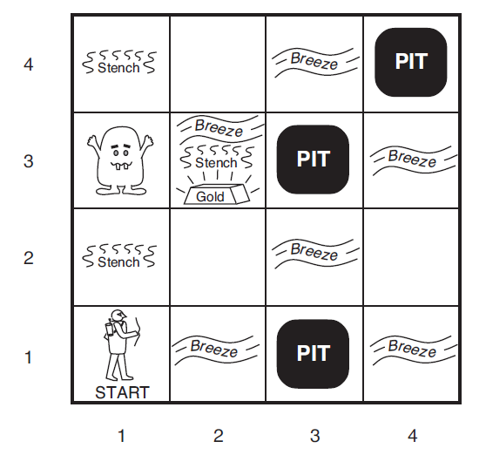
The Key Logic Concepts
Entailment ⊨
Inference ⊢

Slide 6
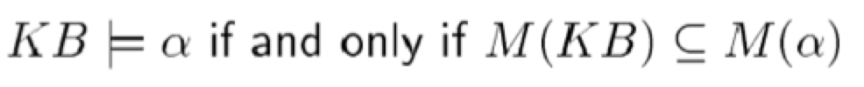
Entailment in wumpus world
α₁ = ¬P_{2,1}
α₂ = ¬P_{2,2}

Slide 7
What you should know
What is entailment, inference? How do they differ?
What are examples of sound or complete inference techniques?
What does satisfiable or valid mean?
What is propositional logic? Basic manipulation rules? Inference rules? What are some of its limitations?

Slide 8
“Entail” =\= “Inference”
KB inference α: derived by a procedure
In robot’s head (or on paper)
sound
complete
KB entails α
Model of KB is a subset of Model of α
Models of symbols: M(KB), M(α), …
are “possible worlds”
In Real Worlds
Entailment must be checked in the real world

Slide 9
Syntax of FOL: Basic Elements
Constants KingJohn, 2, Crown,...
Predicates Brother, >,...
Functions Sqrt, LeftLeg, +, ...
Variables x, y, a, b,...
Connectives ¬, ⇒, ∧, ∨, ⇔
Equality =
Quantifiers ∀, ∃
Notes:
In propositional logic had one kind of symbol, here have four, each with its own role
Constants in language are simplest way of talking about objects in domain, but can also use functions and variables

Slide 10
Example Domain: Arithmetic on Natural Numbers
Objects
Non-negative numbers (0, 1, …)
Relations
NatNum, =, <, >, …
Functions
Successor, +, -, x, integer division, remainder, exponentiation,…
E.g., >(+(5, 20211), -(5111,777)) ∧ =(5,+(3,2))
Notes:
What are the objects, relations and functions in this domain?

Slide 11
What you should know
How does first-order logic differ from propositional logic? How are objects, relations, functions, variables, quantifiers and equality used in first-order logic?
Know how to translate from English to logic
Know how to translate from logic into English
What is Knowledge Engineering? Is it a transfer process or a modeling process?

Slide 12
What you should know
What is Unification? How is it different than pattern matching? When is to used? What is the algorithm? Why is it important for Generalized Modus Ponens?
What is Forward Chaining? What is Backward Chaining? What is the differences between them?
Know how to translate to CNF and Horn clauses
What type of reasoning does Prolog use? What are the advantages and disadvantages?
What does it mean to be Neat or Scruffy?

Slide 13
Type Hierarchies
Subclasses implicitly define a type hierarchy
Also referred to as an ontology, a taxonomy, or a taxonomic hierarchy
Animals
Fish
Amphibians
Reptiles
Birds
Mammals
Robins
Eagles
Ostriches
Penguins

Slide 14
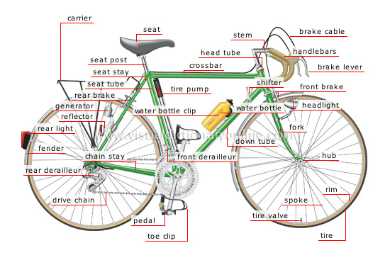
PartOf Hierarchies
As with subclasses, the PartOf relation
induces hierarchies, but of objects
Although can develop a comparable relationship between categories, for example:
CategoryPartOf(Pistons, Engines) could represent that ∀x x ∈ Engines ⇒ ∃y y ∈ Pistons ∧ PartOf(y,x)
Bicycle₁
Seat₁
Frame₁
DriveTrain₁
HandleBar₁
Gears₁
Chain₁
Wheel₁
Wheel₂

Slide 15
Planning
What is the plan to achieve the goal Have(Monkey, Banana)?
Action(ACTION:Go(x,y),
PRECOND: At(Monkey,x),
EFFECT: At(Monkey,y) ∧¬(At(Monkey,x)))
Action(ACTION:Push(b,x,y),
PRECOND: At(Monkey,x) ∧ Pushable(b),
EFFECT: At(b,y) ∧ At(Monkey,y) ∧¬At(b,x) ∧¬At(Monkey,x))
Action(ACTION:ClimbUp(b),
PRECOND:At(Monkey,x) ∧At(b,x) ∧ Climbable(b),
EFFECT: On(Monkey,b) ∧¬Height(Monkey,Low) ∧ Height(Monkey,High))
Action(ACTION:Grasp(o), PRECOND:Height(Monkey,h) ∧Height(o,h) ∧At(Monkey,x) ∧ At(b,x), EFFECT:Have(Monkey,o))
At(Monkey,A) ∧ At(Bananas,B) ∧ At(Box,C) ∧ Height(Monkey,Low) ∧ Height(Box,Low) ∧ Height(Bananas,High) ∧ Pushable(Box) ∧ Climbable(Box)
Start
Go(A,C)
At(Monkey,A)
Push(Box,C,B)
At(Monkey,C) ∧ Pushable(Box)
ClimbUp(Box)
At(Monkey,B) ∧At(Box,B) ∧ Climbable(Box)
Grasp(Banana)
Height(Monkey,High) ∧ Height(Bananas,High) ∧ At(Monkey,B) ∧ At(Bananas,B)
Finish
Have(Monkey, Bananas)

Slide 16
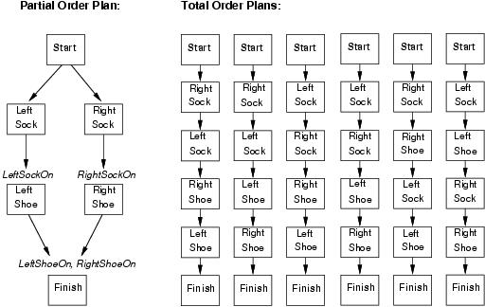
Partial and Total Order Plans
16
Notes:
All the approaches we have seen so far construct totally ordered plans consisting of a strictly linear sequences of actions. This representation ignores the fact that many sub problems are independent.
An alternative is to represent plans as partially ordered structures: a plan is a set of actions and a set of constraints of the form Before(ai, aj) saying that one action occurs before another.
Partially ordered plans are created by a search through the space of plans rather than through the state space.

Slide 17
What you should know
What is Unification? How is it different than pattern matching? When is to used? What is the algorithm? Why is it important for Generalized Modus Ponens?
What is Forward Chaining? What is Backward Chaining? What is the differences between them?
What type of reasoning does Prolog use? What are the advantages and disadvantages?

Slide 18
What you should know
What is an ontology? Why is it useful? What is inheritance? Why is it important?
Know how to create an ontology. How do you define a category? What is reification?
What does it mean that logic is monotonic?
What is knowledge sharing? What are the advantages and disadvantages?
What is planning? Situation calculus? What is the difference between fluents and atemporals?
What is the difference between total order planning and partial order planning?

Slide 19
Sample exam Questions
General Concepts
Propositional Logic
First Order Logic
Inference
Unification & Prolog
Knowledge Representation & Engineering
Planning

Slide 20
1. Logic Concepts
Definitions:
sentences are true in the same models
determine whether sentence entailed by KB
a possible world that defines truth values for all sentences
truth of sentences with respect to models
necessary truth of one sentence given another
sentence is true in all models
sentence is true in some model
produce only entailed sentences
formal structure of sentences
can produce all entailed sentences
Keywords:
____ Syntax
____ Semantics
____ Model
____ Entailment
____ Inference
____ Soundness
____ Completeness
____ Equivalence
____ Validity
____ Satisfiability
I
D
C
E
B
H
J
A
F
G

Slide 21
Converting to CNF

Slide 22
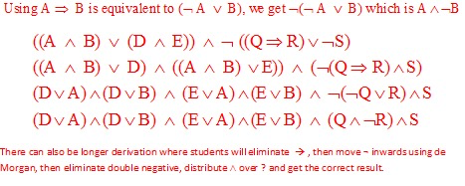
Converting to CNF

Slide 23
Inference
Use resolution and a proof by contradiction to prove D(Bob) from the following knowledge base: ~A(x) ∨ B(x)
A(x) ∨ C(x)
~B(x) ∨ D(x)
~C(x) ∨ D(x)
Please show the complete resolution proof, including all substitutions used (you will lose points for any missing step or substitution). You will get 0 if you use any other method than resolution and proof by contradiction.

Slide 24
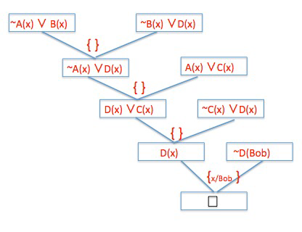
Inference
Use resolution and a proof by contradiction to prove D(Bob) from the following knowledge base: ~A(x) ∨ B(x)
A(x) ∨ C(x)
~B(x) ∨ D(x)
~C(x) ∨ D(x)
~D(Bob)

Slide 25
Unification and Prolog
Answer the questions below given these two rules in Prolog for appending two lists to produce a third:
append([],Y,Y).
append([X|L],Y,[X|Z]) :- append(L,Y,Z).
[4%] Given the query append(A, B, [[1], [2, [3]]]) list all possible θ for A and B:
A B --------------------------------------------------------------------------
θ₁ [] [[1], [2, [3]]]
θ₂ [[1]] [[2, [3]]]
θ₃ [[1], [2, [3]]] []

Slide 26
How to get θ₁ and θ₂? (you do θ₃)
(A, B, [[1], [2, [3]]] )
θ₁
3
2
1
append( [], Y, Y)
(A, B, [[1], [2,[3]]] )
[[2,[3]]]
θ₂
[ [1] | [] ]
1
3
3
2
3
3
1
append( [X|L], Y, [X | Z] )←append(L, Y, Z)
append([], Y, Y).
2
2
1
3
3

Slide 27
Unification and Prolog
Answer the questions below given these two rules in Prolog for appending two lists to produce a third:
append([],Y,Y).
append([X|L],Y,[X|Z]) :- append(L,Y,Z).
When L=[A], Y=[B, C], X=[[D]] then what are the values for:
[3%] Z=
[A, B, C]
[3%] [X|Z]=
[[[D]] , A, B, C]

Slide 28
Unification and Prolog
R1: append([],Y,Y).
R2: append([X|L,Y,[X|Z]) :- append(L,Y,Z).
When L=[A], Y=[B, C], X=[[D]]:
append([[[D]]|[A]], [B, C],[[[D]]|Z]) :- append([A], [B, C], Z).
Subquery: append([A], [B, C], Z)
Z= [A, B, C]
Unify with R2: append([A|[]], [B, C],[A|Z]):-append([], [B, C], Z)
Subquery: append([], [B, C], Z)
Z= [B, C]
Unify with R1: append([], [B, C], [B, C])
Z= [A, B, C] [X|Z]= [[[D]] , A, B, C]

Slide 29
Knowledge Representation

Slide 30
Knowledge Engineering
Circle the letter that corresponds to the best answer for the question:
[4%] What substitutions result from unifying P(x, John, y) with P(Sarah, F(y), z)
These literals fail to unify.
{x/Sarah, John/F(y), y/z}
{x/John, y/Sarah, F/z}
The empty set: { }
[4%] ] Knowledge Engineering is expensive because:
Encoding knowledge in a formal system is hard
It is an iterative modeling process
Domain experts don’t know what they know
All of the above
None of the above

Slide 31
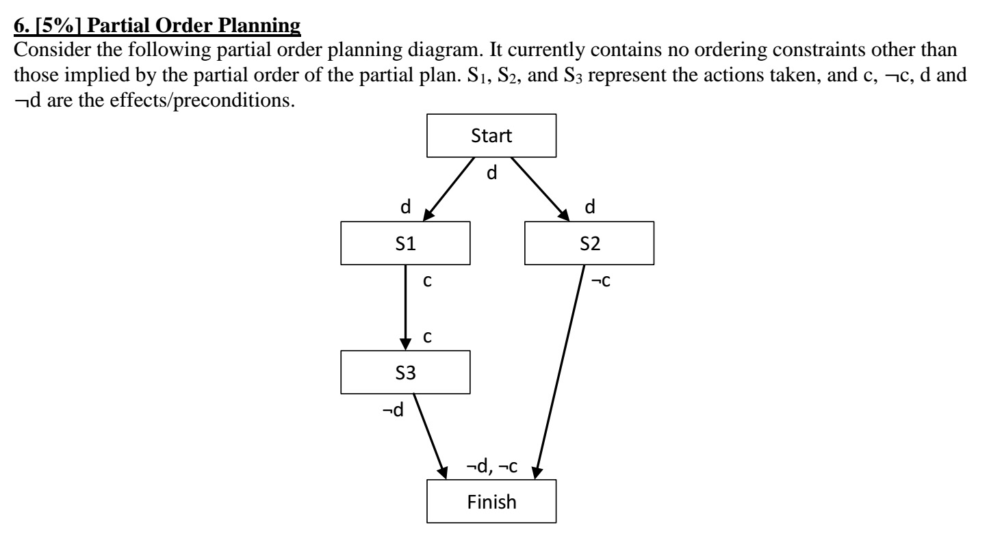
Planning

Slide 32
Planning
Describe the flaw in this partial plan. Show how you would resolve it.
￼The problem with the plan is that S2's effect negates S3's precondition and S3's effect negates S2's precondition. So without any ordering constraints, the plan goes wrong. [4%]
Because the effects of both S2 and S3 are needed for the finish state, and we have no other states providing them, we cannot resolve the problem with current states, even if we add ordering constraints. We need more states. [1%]"

